Slide 1
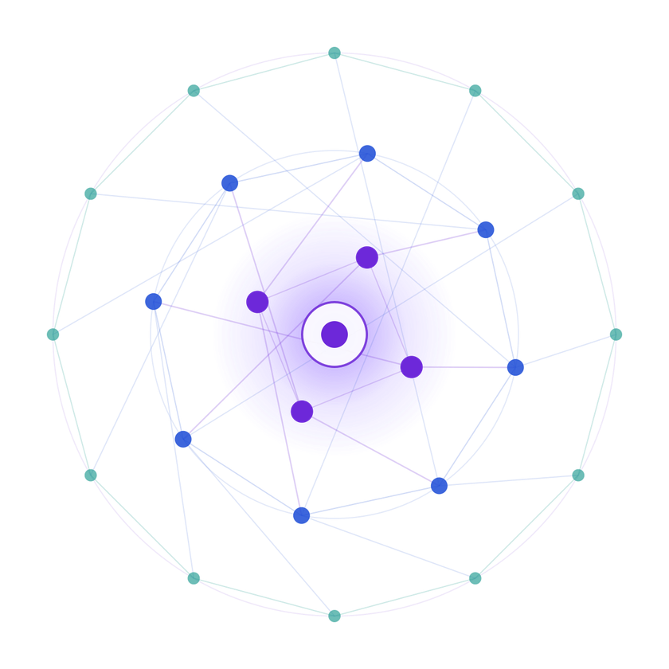
Generative AI Hackathon
SAMSUNG PRISM
3rd Edition 2026 – 27
Theme ID -5
Team Name -Dhurandharr
College Name -Thapar Institute of Technology Member Name & Email 1- Vaishnavi chaudhary vchaudhary_be25@thapar.edu
Member Name & Email 2-Shresth samyak ssamyak_be25@thapar.edu
Member Name & Email 3- Tavleen kaur tkaur4_be25@thapar.edu Member Name & Email 4-Danish Dhanjal
ddhanjal_be25@thapar.edu Submission Github link -

Slide 2

Theme
TRAIL
The Smart Cursor That Understands What You Mean.
Cursor aware• Context-Aware • Interruptible

Slide 3
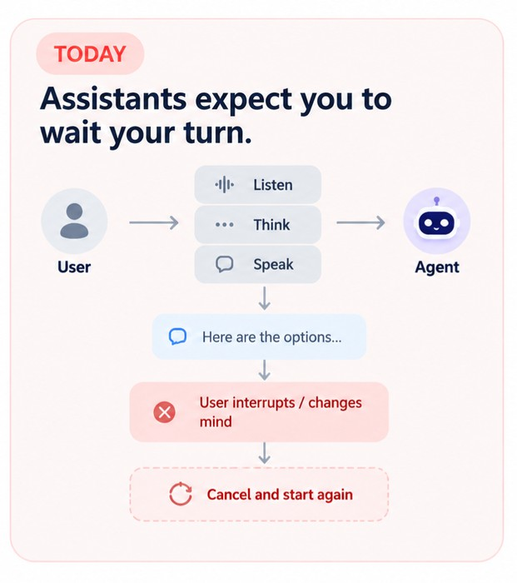
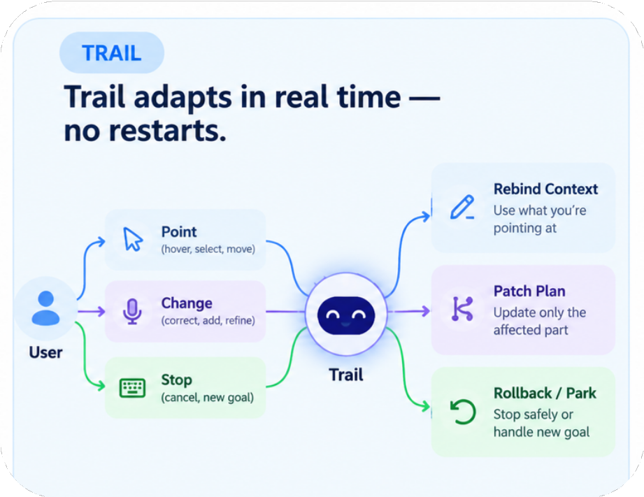
Trail:
Existing Solutions & Gaps
AI Agents Still Expect you to Wait for Your turn
Point
Patch
Rebind
Agents
Rollback
Wait
Listen->Think->Speak
Restart
New info->Cancel->Start Again
Forget
Goal changes->Context gets lost

Slide 4
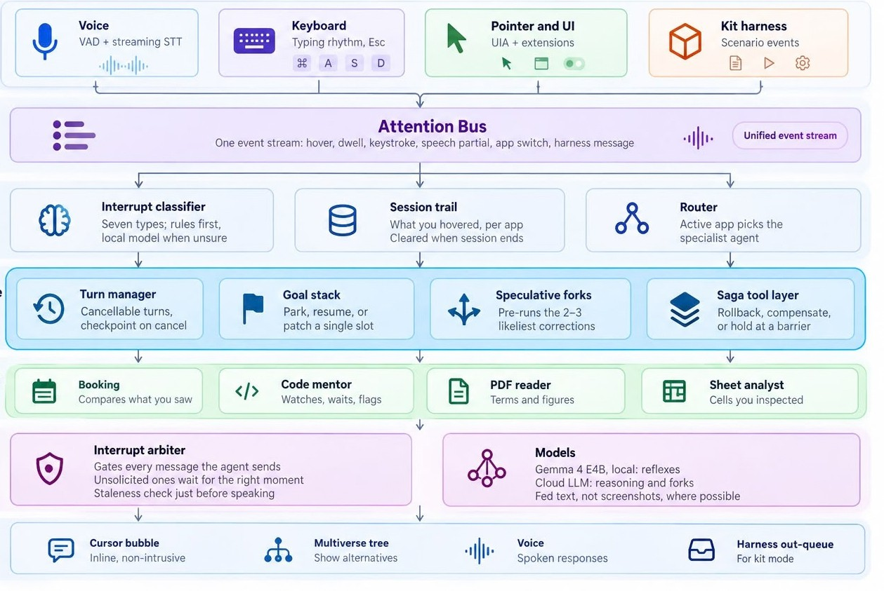
Our Solutions & Architecture Diagram
Trail turns every interruption into an event.
Attention trail
Where you point = context
Hover → understand → remember
Input
Attention bus
Interrupt arbiter
Understanding
Every interruption gets classified
Resume • Patch • Park • Stop
Interruptible Runtime
Specialist
agents
Speculative Forks
2–3 likely alternatives computed in parallel
Predict likely corrections before they happen
Governance
Outputs

Slide 5
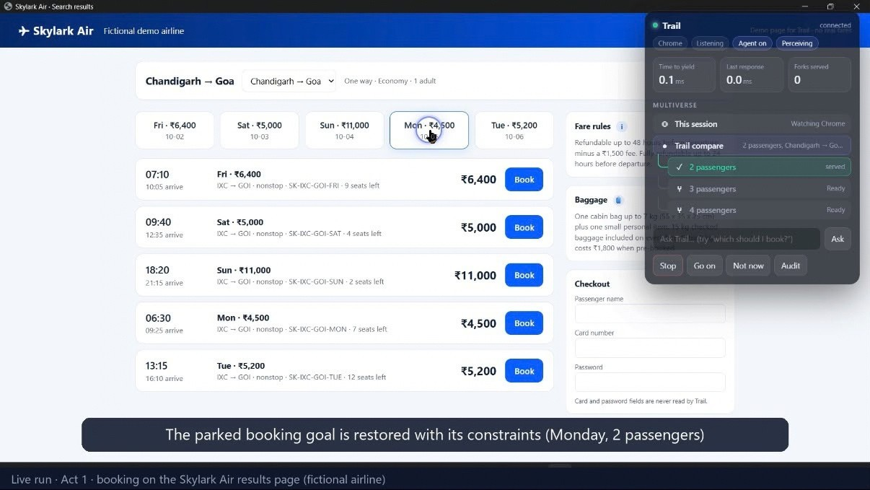
Demo & Product Walkthrough
Watch Trail change its mind — without starting over.

Slide 6




Tools and tech stack used
PERCEPTION
INTELLIGENCE
CORE
Python 3.11 · asyncio · Pydantic · WebSocket
INTERRUPT RUNTIME
Cursor / Dwell
Local Model
DESKTOP
TypeScript · Chrome Manifest V3 · VS Code API
· pywinauto/UIA ·
Electron
Checkpoint
Chrome Extension
Cloud LLM
Goal Stack
AI
Local LLM · Cloud LLM · Silero VAD · Streaming STT · Vision fallback
VS Code Extension
Streaming STT
Interrupt Arbiter
TESTING
pytest · pytest-asyncio · scenario replays
UI Automation
Speculative Forks
Saga / Rollback

Slide 7
Impact & Use case
One Agent Every Workspace.
Browser
Trail carries attention across the apps you already use.
Booking Agent
"Which flight?"
↓
Uses prices + dates + route from attention trail
🖱 TRAIL
Attention → Context → Specialist
"Can I afford it?"
↓
Flight price + budget cell
VS Code Code Mentor
Excel Sheet Analyst
"Why did this break?"
↓
Uses hovered code + diagnostics + terminal
Session-only memory · Local-first perception · Sensitive fields excluded · Explicit confirmation for irreversible actions

Slide 8
Innovation highlights, results and limitations
Beyond “Cancel & Restart"
Results
Current Limitations
Innovation
01 — ATTENTION-DRIVEN AGENT
The cursor becomes context.
Hover + dwell → Attention Trail → grounded response Why different:
Desktop
Yield Latency
Browser + VS Code are the primary implemented/demo layers;
PDF, Excel and Email/Calendar are extensions
of the same architecture.
The agent knows what you are looking at, not just what you said.
Correction Latency
02 — SPECULATIVE INTERRUPTIONS
Predict the correction before it happens.
Speculation cost
Forks consume additional compute
→ therefore they run only within token/tool budgets and are killed when their state
becomes stale.
03 — SAFE, TWO-WAY INTERRUPTION
Fork Hit Rate
Interrupt → Patch / Rollback / Rebind Trail can be interrupted by:
Voice · Keyboard · Cursor
And the agent can also initiate an interruption through its arbiter when appropriate.
Privacy
Safety
Attention data is session-only; sensitive fields are excluded and perception
is designed to be local-first

Slide 9
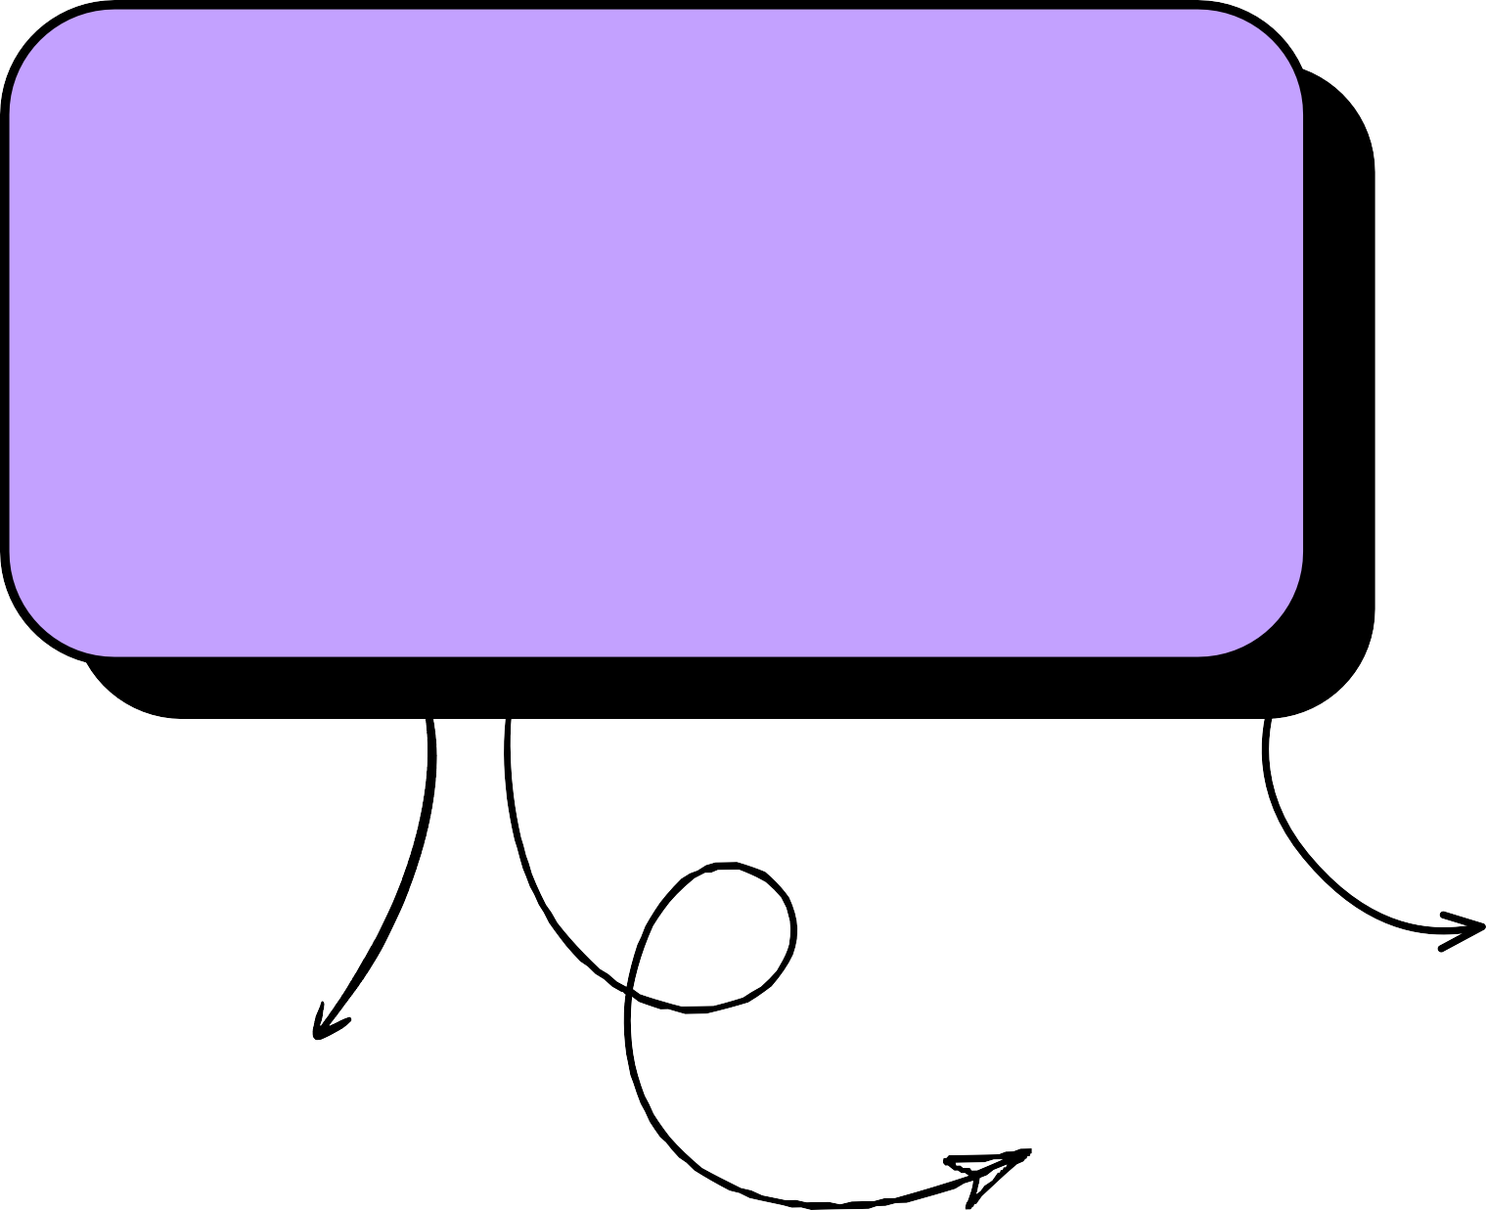
Brownie points slide( differentiation)
Two approaches to personal agents. One starts with your goals — the other starts with your attention.
“THE INTERACTION LAYER IS THE DIFFERENCE”
Trail
Attention — “I’m looking at this.”
OpenAI Dots
Goal — “Handle this project.” Context
Conversation + memory + connected apps
Vs
Context
Cursor + dwell + selected content + session trail
LOCAL-FIRST
Sensitive perception and fast reflexes can stay on-device.
OFFLINE-CAPABLE
YOU CAN INTERRUPT TRAIL. TRAIL CAN INTERRUPT YOU.
PRIVACY BY ARCHITECTURE
Screenshots stay on the laptop. Session memory is cleared when the session ends.

Slide 10
Checklist- Updated on Public GitHub
Working prototype code — public or shared GitHub repo (Y/N) Y README with reproducible setup instructions (Y/N) Y
Demo video, max 5 minutes (YouTube or Drive link) Y Presentation file (PPT or PDF) (Y/N) Y

Slide 11

Thank you
Organised by the Language AI Team and the PRISM Team, Samsung R&D Institute India

